Slide 1
How do we Handle
Research Misconduct Investigations?
Ranjini Ambalavanar, Ph.D.
Division of Investigative Oversight (DIO)
Office of Research Integrity (ORI)
August 2018
Notes:
History:
Research misconduct became a public issue in the United States in 1981 when the first hearing on the emerging problem occurred. The hearing was prompted by the public disclosure of research misconduct cases at four major research centers in 1980. Twelve cases of research misconduct were disclosed in this country between 1974-1981. [Keep that number in mind]
Congress took action in 1985 by passing the Health Research Extension Act. The Act, in part, added Section 493 to the Public Health Service (PHS) Act. Section 493 required the Secretary of Health and Human Services to issue a regulation requiring applicant or awardee institutions to establish "an administrative process to review reports of scientific fraud" and "report to the Secretary any investigation of alleged scientific fraud which appears substantial."
In 1986, NIH assigned responsibility for receiving and responding to reports of research misconduct to its Institutional Liaison Office. This was the first step taken to create a central locus of responsibility for research misconduct within the Department of Health and Human Services (HHS).
In March 1989, PHS created the Office of Scientific Integrity (OSI) in the Office of the Director, NIH, and the Office of Scientific Integrity Review (OSIR) in the Office of the Assistant Secretary for Health (OASH). The sole purpose of these offices was to deal with research misconduct; the creation of OSIR also began the process of removing responsibility for research misconduct from the funding agencies. In May 1992, OSI and OSIR were consolidated into the Office of Research Integrity (ORI) in OASH. In October 1999, the Secretary announced several changes based on the recommendations of the Ryan Commission and the HHS Review Group that were designed to improve its processes for responding to allegations of research misconduct and promoting research integrity among them. The Assistant Secretary for Health, upon recommendations from ORI, was delegated the authority to make final decisions regarding research misconduct findings and administrative actions, except for debarments, subject to appeal.
A new regulation, PHS Policies on Research Misconduct (pdf), became effective on June 16, 2005. The regulation is codified at 42 C.F.R. Part 93.

Slide 2
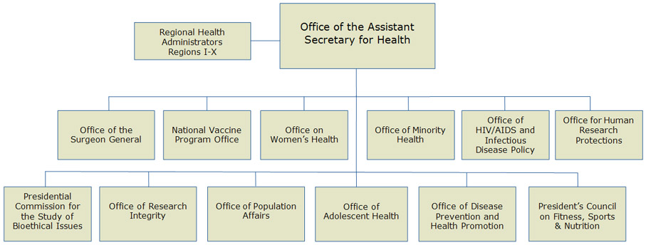

Office of Research Integrity -ORI
Notes:
Promote the integrity of U.S. Public Health Service supported extramural and intramural research programs
Correct the research record/literature, public funds, public health and safety
Teach responsible conduct of research - Resource Development Program, Quarterly ORI newsletter, RIO Boot Camps
Respond to allegations of research misconduct
Oversee institutional investigations, recommend administrative actions for a PHS finding of research misconduct
Protect the complainant from retaliation through regulatory obligations imposed on the research institutions, 42 CFR 93.300 (d)
Monitor institutional compliance with the PHS Policies on Research Misconduct (42 C.F.R. 93)
Receive and assess allegations of research misconduct
Determine ORI jurisdiction
Exclude dishonest investigators from PHS and Federal agency funded research
Make public findings of misconduct so that institutions and individuals will be aware of wrongdoing
Correct or retract scientific papers to protect the integrity of the published literature and the public
Protect the confidentiality of respondents, complainants, and witnesses
Protect the complainant from retaliation through regulatory obligations imposed on the research institutions, 42 CFR 93.300 (d)
Make determinations of misconduct or recommendations for settlement
Participate in civil or criminal cases of alleged research misconduct directly or through other offices, including HHS OIG, US Attorney’s Office, or in collaboration with other federal agencies

Slide 3
Outline
What Is ORI, It’s Mission, Functions, Jurisdiction?
What Is Research Misconduct? PHS Definition, Regulations
What Are the Institutional Responsibilities? Assurance and Reporting
What Are the Steps in Research Misconduct Proceedings?
What If the Respondent Admits to FFP?
What Are the Administrative Actions When PHS Findings Are Made?
What Is the Final Finding? Examples From Published Findings
What Are The Challenges? Reporting to ORI – Some Problems to Avoid
What Tools Are Used to Detect/Confirm Data Manipulations? Examples from Closed Cases
What Are the Resources Available at ORI?
How Do ORI and NSF OIG Processes Compare?

Slide 4
ORI Divisions, Mission, and Functions
MISSION
To promote the integrity of PHS-supported extramural and intramural research programs by responding effectively to allegations of research misconduct and promoting research integrity
GOAL
Oversight Review of research misconduct Investigations
Education in Responsible Conduct of Research
Division of Investigative Oversight
Division of Education and Integrity
Notes:
Our office is divided into three parts:
ORI Director’s Office
Division of Investigative Oversight (DIO)
Reviews and monitors research misconduct (RM) allegations
Provides technical assistance to institutions that respond to allegations of RM
Administers assurance program for institutional policy and reporting of possible research misconduct
Division of Education and Integrity (DEI)

Slide 5
Some Functions of ORI
Division of Investigative Oversight
Division of Education and Integrity
Assesses allegations of research misconduct
Conducts oversight review of misconduct investigations
Manages compliance program
Responds to retaliation complaints
Interacts with other federal agencies
Organizes RIO Boot Camps
Performs Rapid Response for Technical Assistance (RRTA) for advice & technical assistance for institutions
Provides resources for responsible conduct of research (RCR)
Educational materials, website, newsletter, social media
Hosts conferences
Awards grants for research on research integrity
Administers ORI’s Assurance Program (> 5,000 institutions)
Reviews institutional policies for responding to misconduct allegations

Slide 6


Jurisdiction, Supporting Coordination & Collaboration
International Universities
American Association for the Advancement of Science
Association of American Medical Colleges
NIST/DOC
DOE
DOD
Medical
Centers
CDC
FDA
OIG
USDA
Council of Graduate Schools
AHRQ
Biotech
Companies
NSF
OGC
DOI
SAMHSA
Public Health Service
OHRP
Association of American University Professors
National Academy of Science
HRSA
IHS
VA
NIH
DOJ
NASA
US Colleges & Universities
Clinical sites

Slide 7
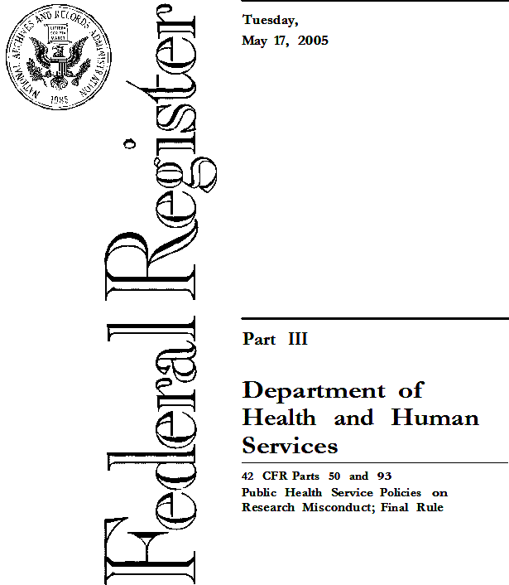
What are the Institutional Responsibilities?
ORI Assurance and Compliance Program
To be eligible for PHS Funding, Institutions:
  must register and have an assurance with ORI
  must have written policies and procedures for responding to allegations of research misconduct
An institution maintains an assurance by:
  complying with the PHS regulation 42 CFR Part 93
  filing the Annual Report on Research Misconduct cases
  submitting its policy for review when requested by ORI, and
  revising its policy when requested by ORI for compliance with the PHS regulation

Slide 8
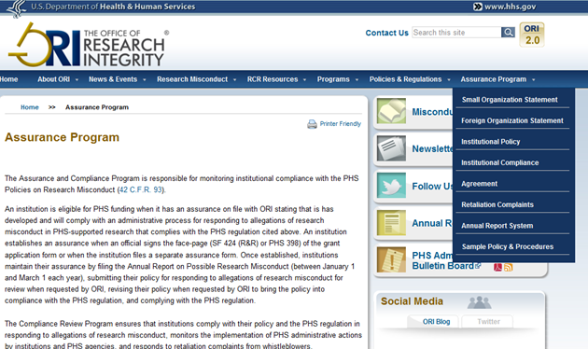
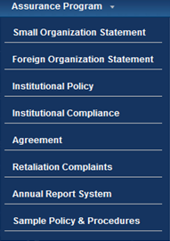
ORI Website: www.ori.hhs.gov/

Slide 9
Research misconduct - 42 CFR § 93.103
Fabrication, falsification, or plagiarism in proposing, performing, or reviewing research, or in reporting research results.
Fabrication is making up data or results and recording or reporting them.
(b) Falsification is manipulating research materials, equipment, or processes, or changing or omitting data or results such that the research is not accurately represented in the research record.
(c) Plagiarism is the appropriation of another person's ideas, processes, results, or words without giving appropriate credit.
Notes:
ORI’s Plagiarism Policy:
https://ori.hhs.gov/ori-policy-plagiarism
ORI considers plagiarism to include both the theft or misappropriation of intellectual property and the substantial unattributed textual copying of another's work.
It does not include authorship or credit disputes.
Many allegations of plagiarism involve disputes among former collaborators who participated jointly in the development or conduct of a research project, but who subsequently went their separate ways and made independent use of the jointly developed concepts, methods, descriptive language, or other product of the joint effort.
The ownership of the intellectual property in many such situations is seldom clear, and the collaborative history among the scientists often supports a presumption of implied consent to use the products of the collaboration by any of the former collaborators.

Slide 10
Research Misconduct Findings Require….
The misconduct be committed intentionally, knowingly, or recklessly.
There be a significant departure from accepted practices of the relevant research community.
The allegation be proven by a preponderance of the evidence (more than 50% likely).
Who
No honest error/differences in opinion
Significant departure
FFP
Intent
Preponderance of the evidence

Slide 11
What is Not Research Misconduct Under PHS Definition?
Honest error or differences in interpretations
Authorship or credit disputes
Disputes among collaborators, publication issues
Intellectual property issues/patents
Misuse of human subjects (OHRP - Office for Human Research Protections)
Misuse of animals in research (OLAW - Office of Laboratory Animal Welfare)
Conflict of interest issues (NIH grants policy office)
Financial mismanagement (OMA - Office of Management Assessment)
Radiation or biosafety hazards (ORS - Office of Research Services)
Other regulatory violations (FDA)

Slide 12
ORI Queries vs Misconduct cases

Slide 13
Steps in Research Misconduct Proceedings
Additional evidence:
Interviews
Expert opinion
Forensic analysis
Additional Issues
Allegation
Assessment
Inquiry
Investigation
ORI
oversight
Agree, or
  Insufficient evidence for ORI finding
From:
Within institution
Colleagues
Peer reviewers
Coauthors
Journal editors
60 days
120 days
Research Integrity Officer (RIO)
Initial assessment
Organizes the remaining institutional processes
Recommend Administrative Actions based on:
Scope of the misconduct
Aggravating /mitigating factors
Actions Include:
Fix research record
Require special certification(s)
Suspend/terminate PHS-funding
Supervise offender(s)
Prohibit PHS-advisory role
Debar from future funding
To:
Institution:
  Supervisor, Chair
  RIO
Funding agency
Journal
ORI
All ORI Findings are published in The Federal Register, the ORI website and newsletter, the NIH website
Notes:
An inquiry is warranted if the allegation:
Fits the PHS definition of Research Misconduct/Institutional Policy
Is sufficiently credible and specific so that potential evidence of research misconduct may be identified (see 42 CFR 93.307)
Other concerns that don’t fit the definition of RM? Need to refer?
Confidentiality 42 CFR §93
Disclosure of the identity of respondents and complainants in research misconduct proceedings is limited, to the extent possible, to those who need to know, consistent with a thorough, competent, objective and fair research misconduct proceeding, and as allowed by law.
Except as may otherwise be prescribed by applicable law, confidentiality must be maintained for any records or evidence from which research subjects might be identified. Disclosure is limited to those who have a need to know to carry out a research misconduct proceeding.

Slide 14
What Are the PHS Administrative Actions?

Slide 15
Institutional Misconduct Findings = PHS Findings?
ORI accepts institutional reports and sometimes declines to pursue separate PHS findings for various reasons
42 C.F.R. 93.319: “An HHS finding or settlement does not affect institutional findings or administrative actions based on an institution’s internal standards of conduct.”

Slide 16
Challenge is…
Adapting a scientific subject review within a legal context
It requires
  Careful documentation
  Following specific timeline
  Gathering evidence –Timely Sequestration
  Chain of custody
  Written policies to cover all steps
  Review of evidence by experts in the field
  Cite evidence appropriately
Notes:
Many ORI cases rely on prompt sequestration of evidence, including hard drives and portable storage media, to ensure that manipulated images can be shown to have originated with a particular individual.
Sequestering Evidence: 93.305(a) – Point to Consider
Either before or when the institution notifies the Respondent of the allegation, inquiry or investigation, promptly take all reasonable and practical steps to obtain custody of all the research records and evidence needed to conduct the research misconduct proceeding, and;
inventory the records and evidence
Best Evidence
Is it labeled so that you know where it came from?
How is access to the evidence limited/controlled?
Stored properly?
Have appropriate anti-shock and anti-static precautions been taken?
Time-date stamps are often probative with respect to how and when the manipulations occurred.
The process is frequently confounded by
Intimidation by aggressive outside counsel
lack guidance/training for IRB on misconduct issues

Slide 17
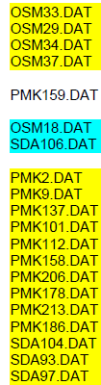
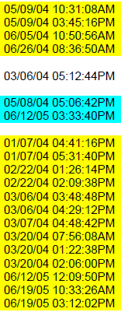
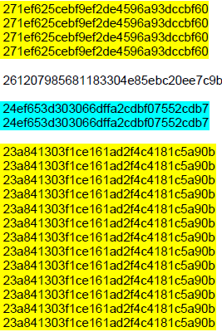
Encase - Batch Analysis of 293 (Corrupted)
Raw Stereology data files from 13 experiments
File Name
Generated at
Hash Value/Electronic fingerprint
The hash value for each file is unique. Only a copy of a particular file will yield the same hash value.
The hash value is determined by the file's contents. It is independent of the file's name.
Notes:
The hash feature of EnCase@ software (EnCase) allows the investigator to create a hash value, a digital fingerprint, for any file.
The hash value for each file is unique. Only a copy of a particular file will yield the same hash value.
The hash value is determined by the file's contents. It is independent of the file's name, so the hash value of a file that is included in the hash library will be detected by EnCase, even if the file's name has been changed.
Thus the file and its copy can have different names, but still have the same digital fingerprint.
The chance of 2 files having same Hash algorithm is 2¹²⁸, that is 1 in 340,282,366,920,938,463,374,607,431,768,211,456 or 340 billion, billion, billion.

Slide 18

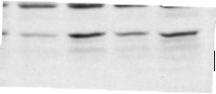
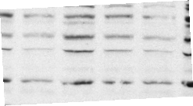
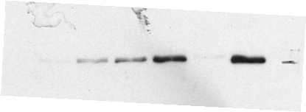
Is this Figure Authentic?
a.
*
*
b.
IGF-I (100 ng/ml) - + + + + + + + +
TNF (0.01 ng/ml) - - + - - + - - -
Sphingomyelinase (1 μM) - - - + - - + - -
Ceramide (1 μM) - - - - + - - + -
Fumonisin (10 μM) - - - - - + + + +
97 kD
97 kD
c.
*
*
.
.

Slide 19
Is this Figure Authentic?
a.
*
*
b.
IGF-I (100 ng/ml) - + + + + + + + +
TNF (0.01 ng/ml) - - + - - + - - -
Sphingomyelinase (1 μM) - - - + - - + - -
Ceramide (1 μM) - - - - + - - + -
Fumonisin (10 μM) - - - - - + + + +
97 kD
97 kD
c.
*
*
.
.

Slide 20













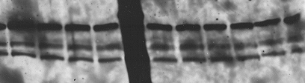










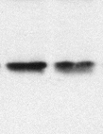












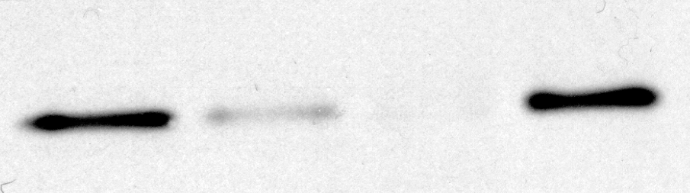



Library 2
Raw Data?
In file named
“Library
Notes:
A file called “Library”’ in Respondent’s computer. Why is it false? None of the bands are labeled or proteins identified.

Slide 21
What If The Respondent Admits to FFP?
Usually Respondent settles with ORI when making an adequate admission.
If no settlement, the institution must complete the investigation process to make institutional findings for ORI oversight review.
From the outset, be prepared to handle a full investigation. Do not wrap up the proceedings prematurely.
42 C.F.R. §93.316
  ORI expects institutions to carry inquiries and investigations through to completion and to pursue diligently all significant issues.
    An institution must notify ORI in advance if the institution plans to close a case at the inquiry, investigation, or appeal stage , . . .
Notes:
ORI determines if the case warrants PHS research misconduct findings.
Usually Respondent settles with ORI when making an adequate admission.
If no settlement, the institution must complete the investigation process to make institutional findings for ORI oversight review.
From the outset, be prepared to handle a full investigation. Do not wrap up the proceedings prematurely.

Slide 22
Admission Should be in Writing
  A verbal admission is insufficient
    No documentation of admission
    Respondent (R) may change mind, leave the country, become unresponsive
  What statements should not be in written admissions and why?
      Respondent admits to “errors,” not RM
      Claims lack of knowledge, training, instrument failure
      R does not disclose where affected data were used
    R does not disclose full scope of FFP
  What should be included in written admission?
    Knowing and intentional manipulation, F/F, and identify affected data
Notes:
Case where RIO said admission made. When ORI questioned RIO said oral admission to PI (not to RIO) – Post doc left and went to another university. When contacted by ORI, R said he was coerced by PI who threatened to make problems for his new post-doc position.

Slide 23
What is the Final Finding?
Framing an Issue
Information Included
Who did it?
Fabricated/falsified/plagiarized?
What type of data?
How many (scope)?
Where presented?
What was the manipulation (showing intent)?
Why is it F/F and significant

Slide 24
Issues/Findings - Specific and detailed
Respondent intentionally, knowingly, and recklessly engaged in research misconduct by … falsifying histopathological data reported in fifty seven (57) images in two (2) published papers, one (1) submitted manuscript, two (2) poster presentations, and seven (7) of Respondent’s supervisor’s grant applications and fabricating data for the corresponding nineteen (19) summary bar graphs that were based on those false images.
Specifically, Respondent trimmed, resized and/or flipped …and used portions of Figure 6 (right panel) of a draft R21 CA120017–01 grant application, representing an image of liver tumor two (2) days after injection of Cp/plc- bacteria, to represent unrelated results from different experiments in:
Figure … in grant …

Slide 25
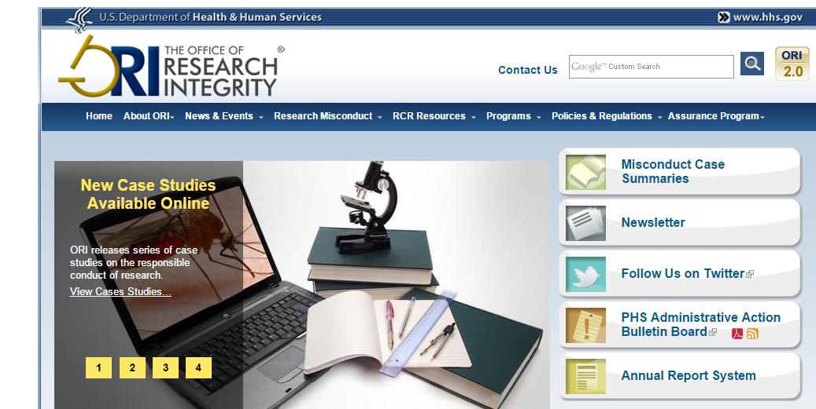
Case Summaries and NIH eRA Links to PHS Administrative Action Bulletin Board
Notes:
Consider recovery of funds

Slide 26
Reporting to ORI - Some Problems to Avoid
Committee members lack appropriate expertise
Poorly conducted interviews
Failing to address the full scope of misconduct
Weak evidence or rationale for findings or no findings
Poorly written and/or poorly organized Reports
Inadequate Sequestration
Insufficient admissions

Slide 27
What are Some Tools used to Detect/Confirm Data Manipulations?
Images
Blots
Cells
Tissue Micrographs
Physiological recordings
Microarray data
FACS data
  Plagiarism
  Sabotage
Visual analyses
  Images
  Numbers
  Records
Numerical data tools
  Excel tools
  Digiprobe
Forensic tools
  Encase analysis
  Photoshop tools
iThenticate to detect plagiarism
Types of Data
Numerical Data
Excel Spread Sheets
Clinical Data
Enrollment forms
Samples
Study results
Notes:
Many of the data tools and expertise are within ORI.
Special experts are recruited as and when appropriate through legally admissible process. For example COI clearance, singing confidentiality statement etc.

Slide 28
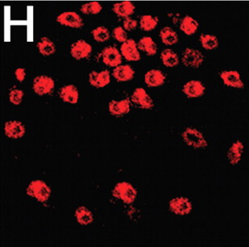

Slide 29
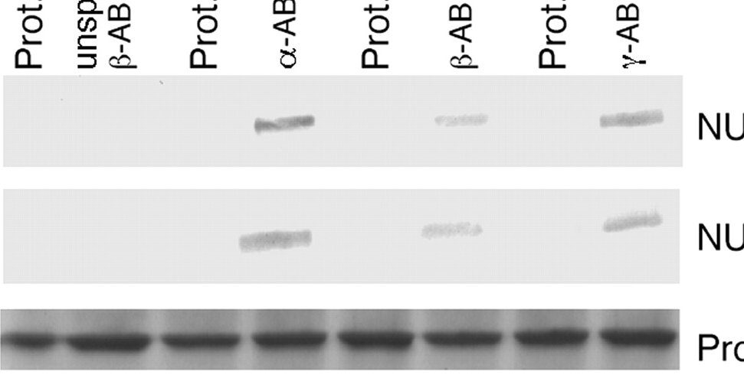
rotated
rotated
duplicated
Portion of On-Line Journal Image
Note Multiple Inconsistencies

Slide 30
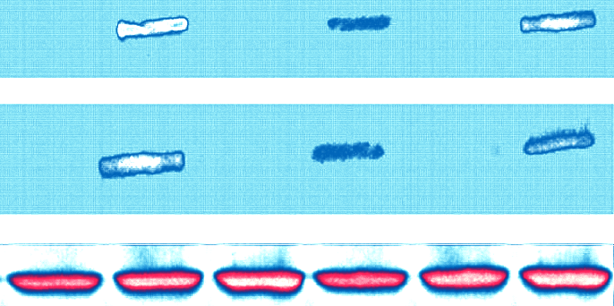






Photoshop Gradient Map

Slide 31
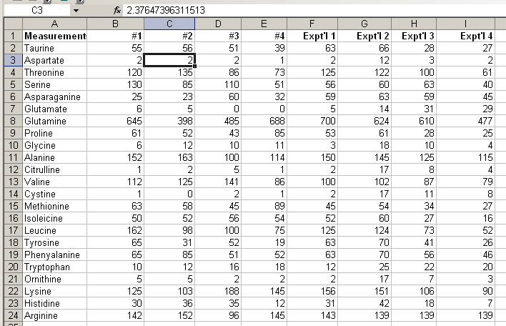
Functions in Spreadsheets
In this spreadsheet-
Questionable features in hand-entered data
Use of formula to create new data

Slide 32
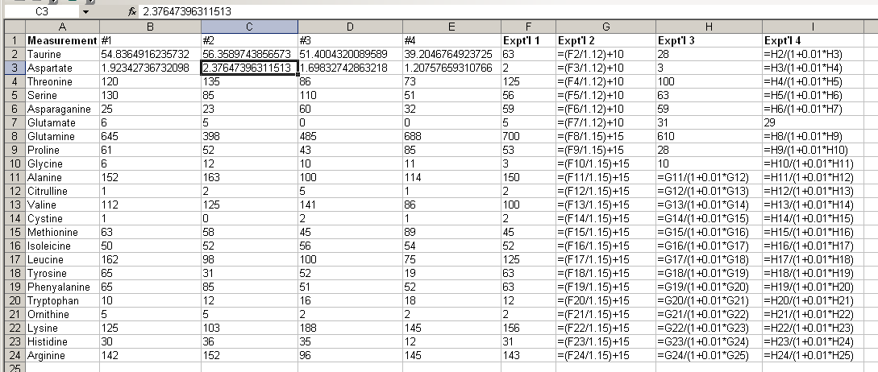
Use “Show Formulas”
Tools>Options>View>Window Options; check formulas
Reveals that formulas were
used to generate selected data

Slide 33
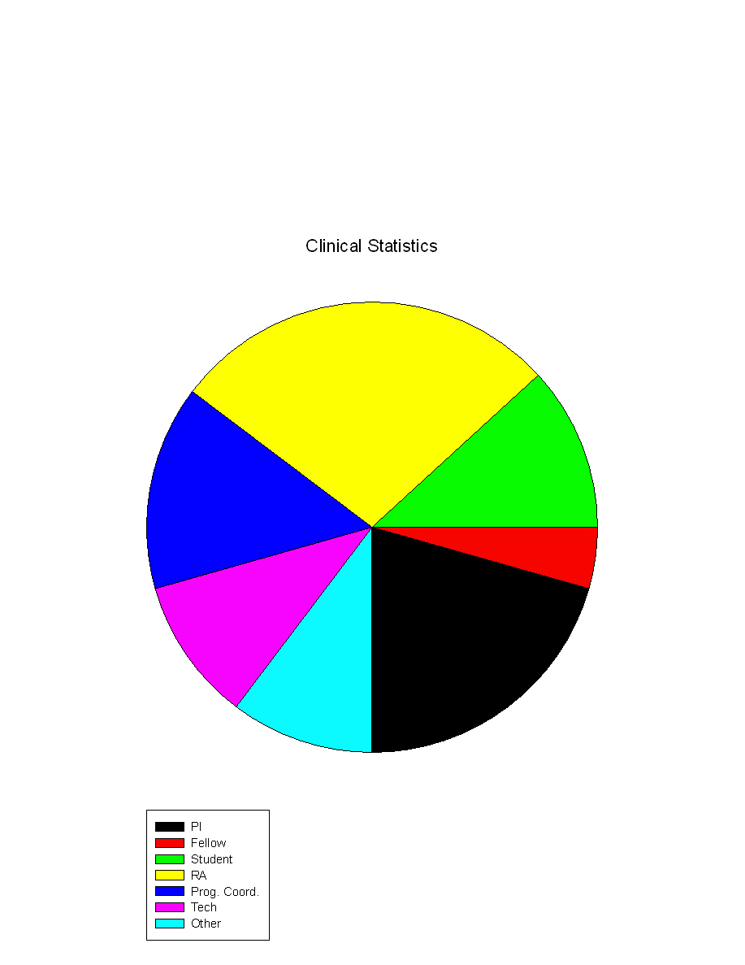
Clinical Research Data
Interviews
Entry criteria
Screening logs
Approval forms
Follow-up exams/data
Consent forms
Test scores
Laboratory results
Patient data
Number of subjects
Dates of procedures
Protocol
Study results
Respondents in 68 cases with finding
Research Asst./Assoc.
Research Coordinator/Nurse Practitioner
Students
Fellows
Technician
All Professors
Other
Notes:
Substituting one subject’s record for another
Altering dates and results for required eligibility tests
Backdating patient records to fit study protocol
Falsifying patient’s test results
Selective suppression of results or reporting data from a sub-set of patients only
Falsely reporting a larger “n” or number of subjects or falsifying outcome of statistical tests
Selective “omitting” of data
Using the blood/tissues from one subject to represent two or more additional subjects
Falsifying interview results (interviews were not conducted)
Falsifying breath analyzer results (recording “0.00” when test was not conducted)
Representing animal data as if it were from humans
Falsifying images in presentations and published reports

Slide 34
Post Mastectomy treatment (tamoxifen vs. placebo)
Falsified NSABP enrollment form
Physical exam record from Pt. Chart
Enrolled patient despite skin findings that would have made patient ineligible
Notes:
Here is the original exam indicating Peau d’orange (a sign of inflammatory Bca).
You may think that improperly enrolling some one in a trial is benign, “they didn’t meet the enrollment criteria, so what, we might still get some useful information out of them.”
EXAMPLES

Slide 35
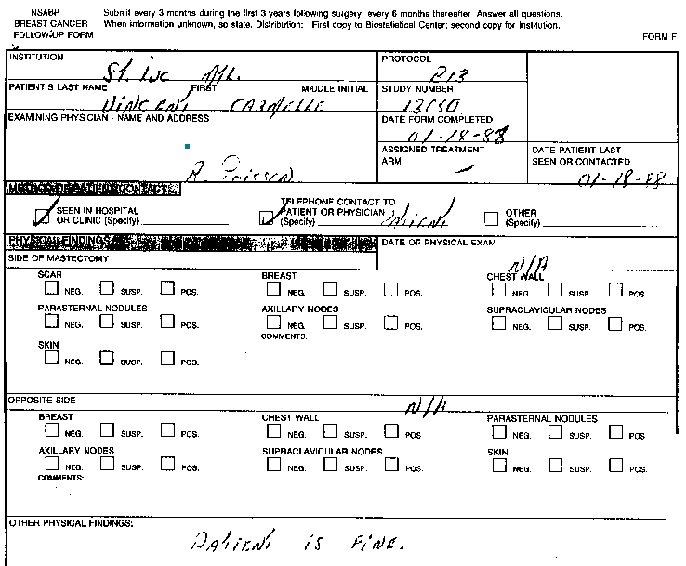
Follow up Visits For Patient 10: dated “01-18-88”

Slide 36
Follow up Visits For - Patient 10: dated “08-31-88”

Slide 37
Follow up Visits For - Patient 10: dated “11-29-88”

Slide 38
Follow up Visits For - Patient 10: dated “03-21-89”

Slide 39
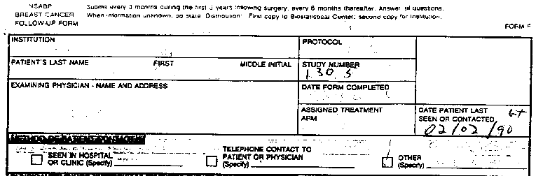
Follow up Visits For - Patient 10: dated “02-02-90”

Slide 40
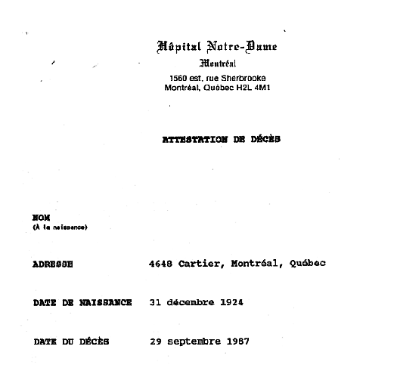
Patient 10: Death Certificate “September 29, 1987”
28 months prior to last reported follow-up (2-2-90)
4 months prior to first shown (1-18-88) follow up
Notes:
Fabrication of follow up records
Death Certificate is real.

Slide 41
Common Concerns Leading to Questioning Your Research
Laboratory Culture
  Inadequate supervision, guidance or training
  Excessive work-load
  PI accepting summary data or prepared tables/graphs
  PI not present in the laboratory
  Demanding desired results to meet a deadline
  Use of threats and intimidation as tactics to obtain results
Lack of Data
  Sloppy research records
  No guidance or standards for keeping data
  Not protected over time (conveniently lost)
  Accessible to multiple staff
  Not backed up and stored securely
  Researchers take data from the institution

Slide 42
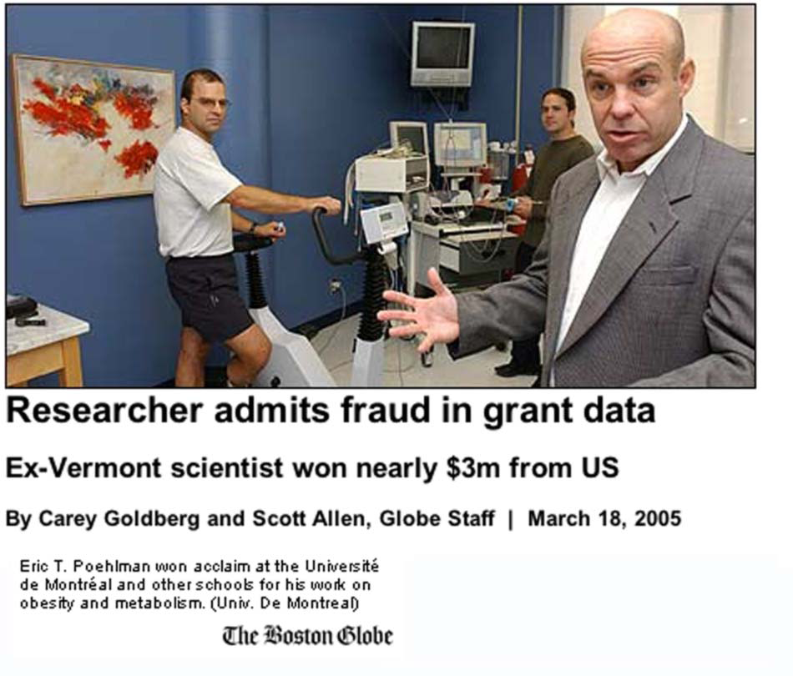
ORI Collaboration - US Attorney’s Office
A Major Misconduct Case -Eric T. Pohelman, University of Vermont
Dr. Poehlman falsified and fabricated data in NIH grant applications and published articles over a 10 year period with $3 million NIH funding
Falsifications and fabrications were made in applications worth over $11 million for all submitted grants
ORI confirmed 21 of the 22 findings made by UVM and made 35 additional findings
ORI/ASH actions - lifetime debarment from Federal funding and retraction of ten published papers
Notes:
The misconduct affected studies related to disease prevention, including research on the health of older men and women, the effect of diet, exercise, menopause status, hormone replacement, and disease status.
Dr. Poehlman claimed to have conducted a longitudinal study of the menopause transition involving 35 women seen twice six years apart.
The study was not conducted: Dr. Poehlman falsified the number of subjects at T1 and never saw the women a second time.
This study was reported in a 1995 paper in the Annals of Internal Medicine and five follow-up papers as well as in many grant applications.
The data from the Annals paper claimed to show that the menopause transition quickly leads to undesirable changes in weight, fat mass, resting metabolic rate, leisure time activity, and waist-to-hip ratio.
None of these conclusions were legitimate (although cross-sectional studies have suggested that changes do occur eventually).
Additional fabricated results from this study were reported in later papers and grant applications.
Many of these false claims were also made in talks given by Dr. Poehlman, some of which were documented, allowing findings of scientific misconduct to be made
Starting immediately after being accused of misconduct, Dr. Poehlman aggressively attempted to obstruct the University investigation, and subsequently the Government’s review.
He accused his young colleagues of having falsified the 678 database.
He went to Federal court to attempt to block UVM from notifying ORI of the pending investigation.
The Federal government banned Dr. Poehlman from NIH funding for life and sentenced him to Federal prison for one year.
The UVM investigation, ORI, and the U.S. Attorney’s office determined that Dr. Poehlman falsified data in additional papers and grant applications in areas as wide ranging as Alzheimer’s disease, the effect of endurance training on RMR, and the effects of hormone replacement therapy on post-menopausal women.

Slide 43

Involvement of the Vermont U.S. Attorney
Civil and criminal fraud investigations, assisted by ORI and HHS OIG
Defended civil litigation brought by Dr. Poehlman to prevent mandatory reporting of misconduct investigation to ORI
Decided that false claims of Dr. Poehlman warranted a criminal charge and personal monetary settlement of $180,000
Dr. Poehlman sentenced to jail term of one year and a day based on admission to one felony count and ordered to a federal prison work camp in Maryland
The whistleblower later filed a qui tam suit under Federal fraud laws and received a relator’s share of 12% ($22,000) of the Federal recovery of $180,000
Notes:
U.S. attorney’s office defended civil litigation brought by Dr. Poehlman to prevent mandatory reporting of misconduct investigation to ORI.
Opened civil and criminal fraud investigations into Dr. Poehlman’s research activities, assisted by ORI and HHS OIG.
Decided that false claims of Dr. Poehlman warranted a criminal charge and personal monetary settlement of $180,000.
Dr. Poehlman sentenced to jail term of one year and a day based on admission to one felony count and ordered to a federal prison work camp in Maryland.
ORI/ASH actions against Dr. Poehlman include lifetime debarment from federal research funding and retraction/correction of ten published papers.
The whistleblower in this case later filed a qui tam suit under federal fraud laws and received a relator’s share of 12% ($22,000) of the Federal recovery of $180,000.

Slide 44
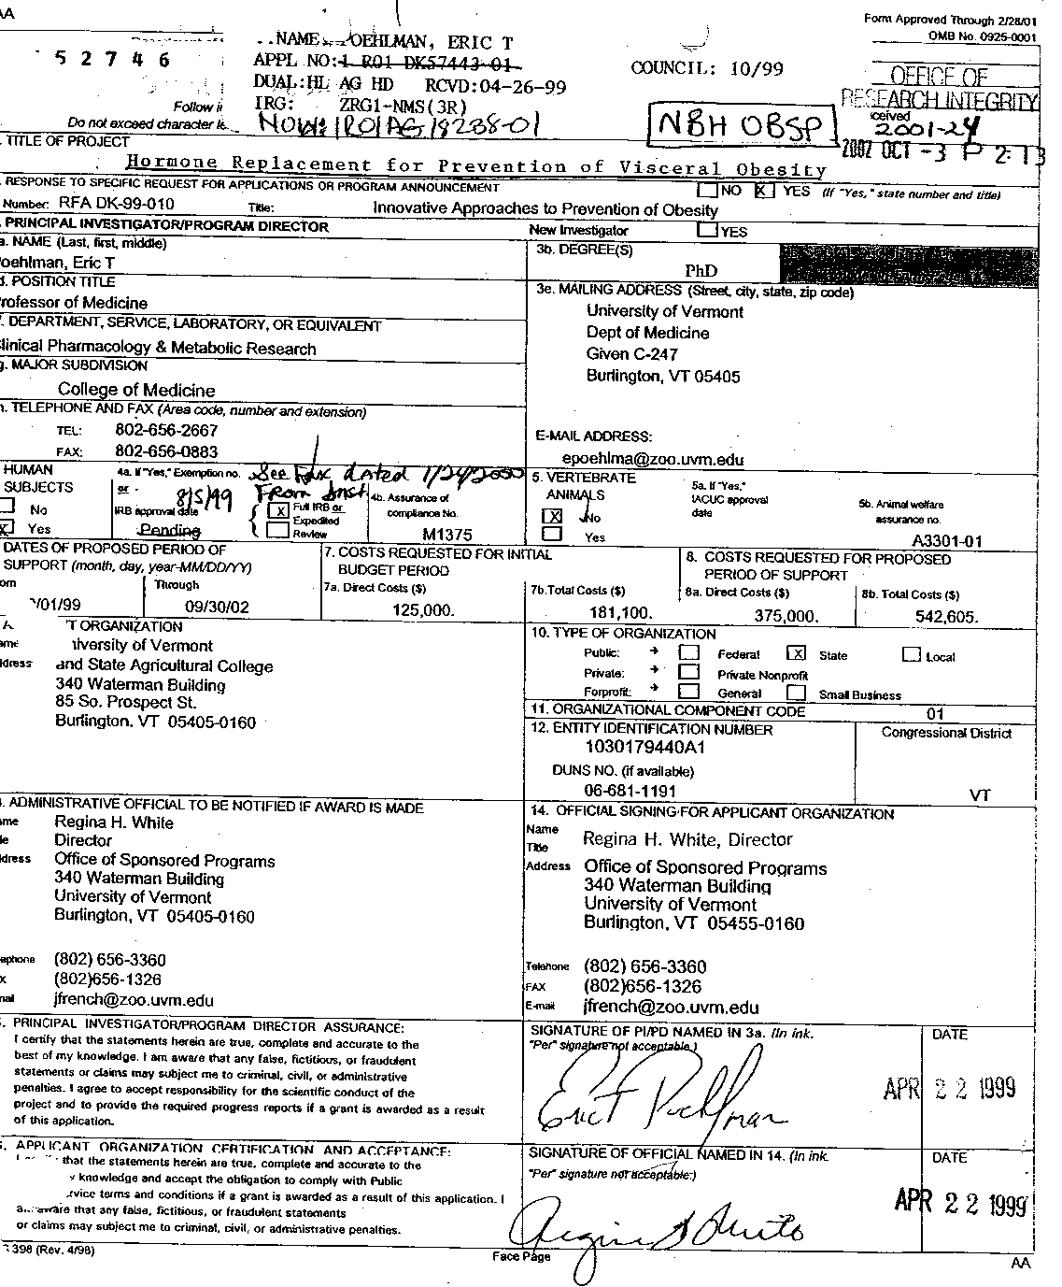
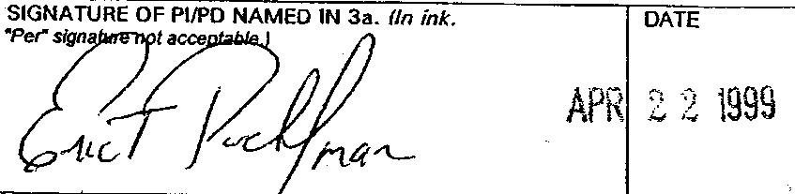
What Made Dr. Poehlman Plead Guilty to a Felony?
This is what led Dr. Poehlman pleading guilty to a felony
Assurance on application form PHS 398, #15
Principal Investigator/Program Director Assurance: I certify that the statements herein are true, complete and accurate to the best of my knowledge. I am aware that any false, fictitious, or fraudulent statements or claims may subject me to criminal, civil, or administrative penalties. I agree to accept responsibility for the scientific conduct of the project and to provide the required progress reports if a grant is awarded as a result of this application

Slide 45
ORI and National Science Foundation (NSF)
  Responsible for intake/assessment of allegations
  Refer matters to university for investigation
  Make recommendations regarding administrative actions
  Work together on matters of joint jurisdiction
  ORI NSF
  Negotiates Voluntary Settlements Refers settlement requests to NSF OIG
  Oversees grantee investigations Ability to independently investigate
  Not a law enforcement agency LE agency with subpoena authority
  Search warrant capability (criminal)
  Division of Education/Integrity Limited outreach by investigative staff
  Publishes all findings with names All closeouts online but names
  redacted except in debarment cases

Slide 46
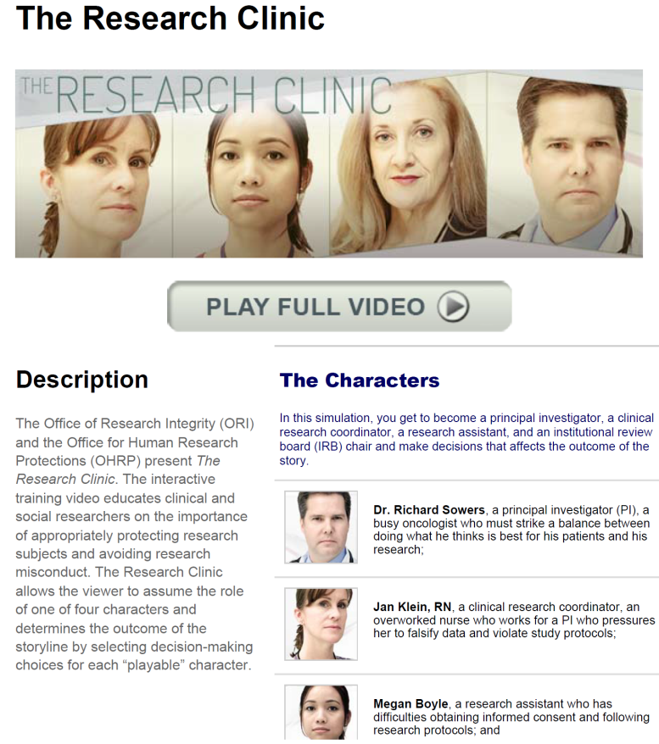
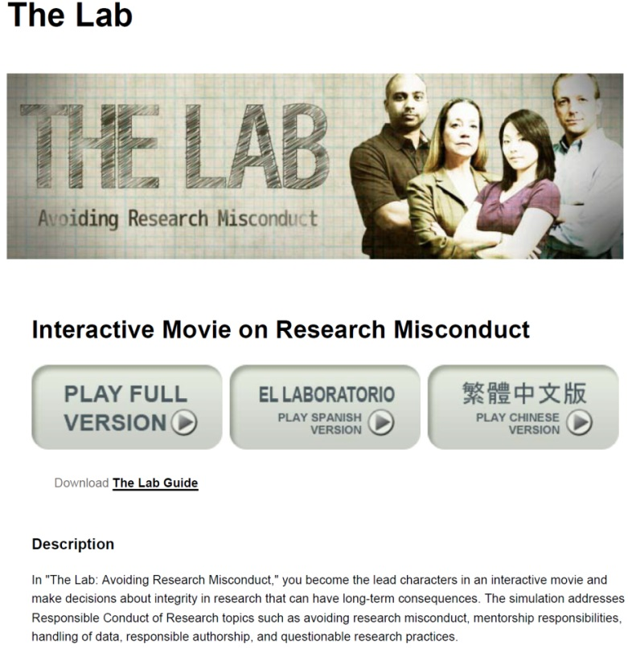
ORI Resources
ORI website http://ori.hhs.gov/
Educational videos
Case Summaries
Forensic droplets

Slide 47
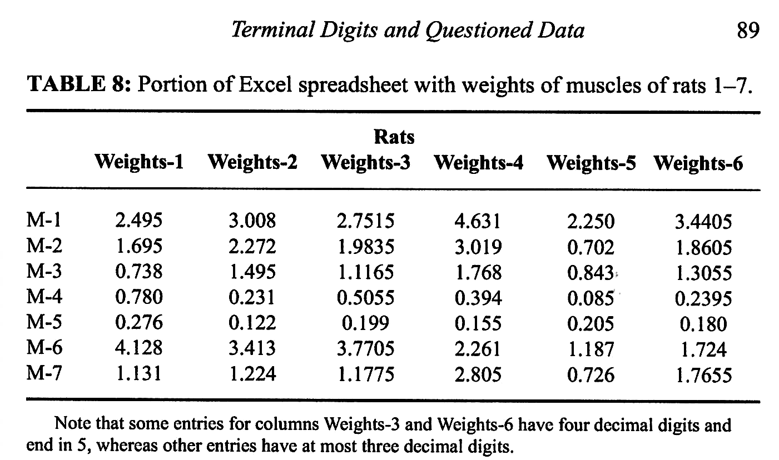
Numerical Data Inconsistencies
₊
=
₊
=
From: Mosimann, et.al., Accountability in Research, 9: 75-92, 2002.
Data with more digits than others in a spreadsheet may reveal an additional calculation
Found numbers in columns 3 and 6 were fabricated
Mean columns 1 + 2 = column 3
Mean columns 4 + 5 = column 6

Slide 48
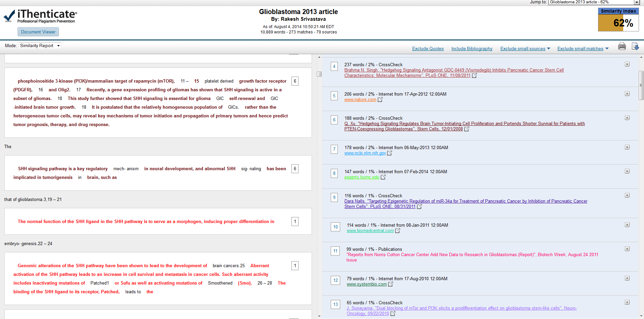
Plagiarism: Text analysis with iThenticate
Notes:
iThenticate database content
40 Million scholarly articles, books, and conferences proceedings from 115,000 scientific, technical, and medical journals
92 Million published works from journals, periodicals, magazines, encyclopedias, and abstracts
50 Billion current and archived web pages

