Slide 1
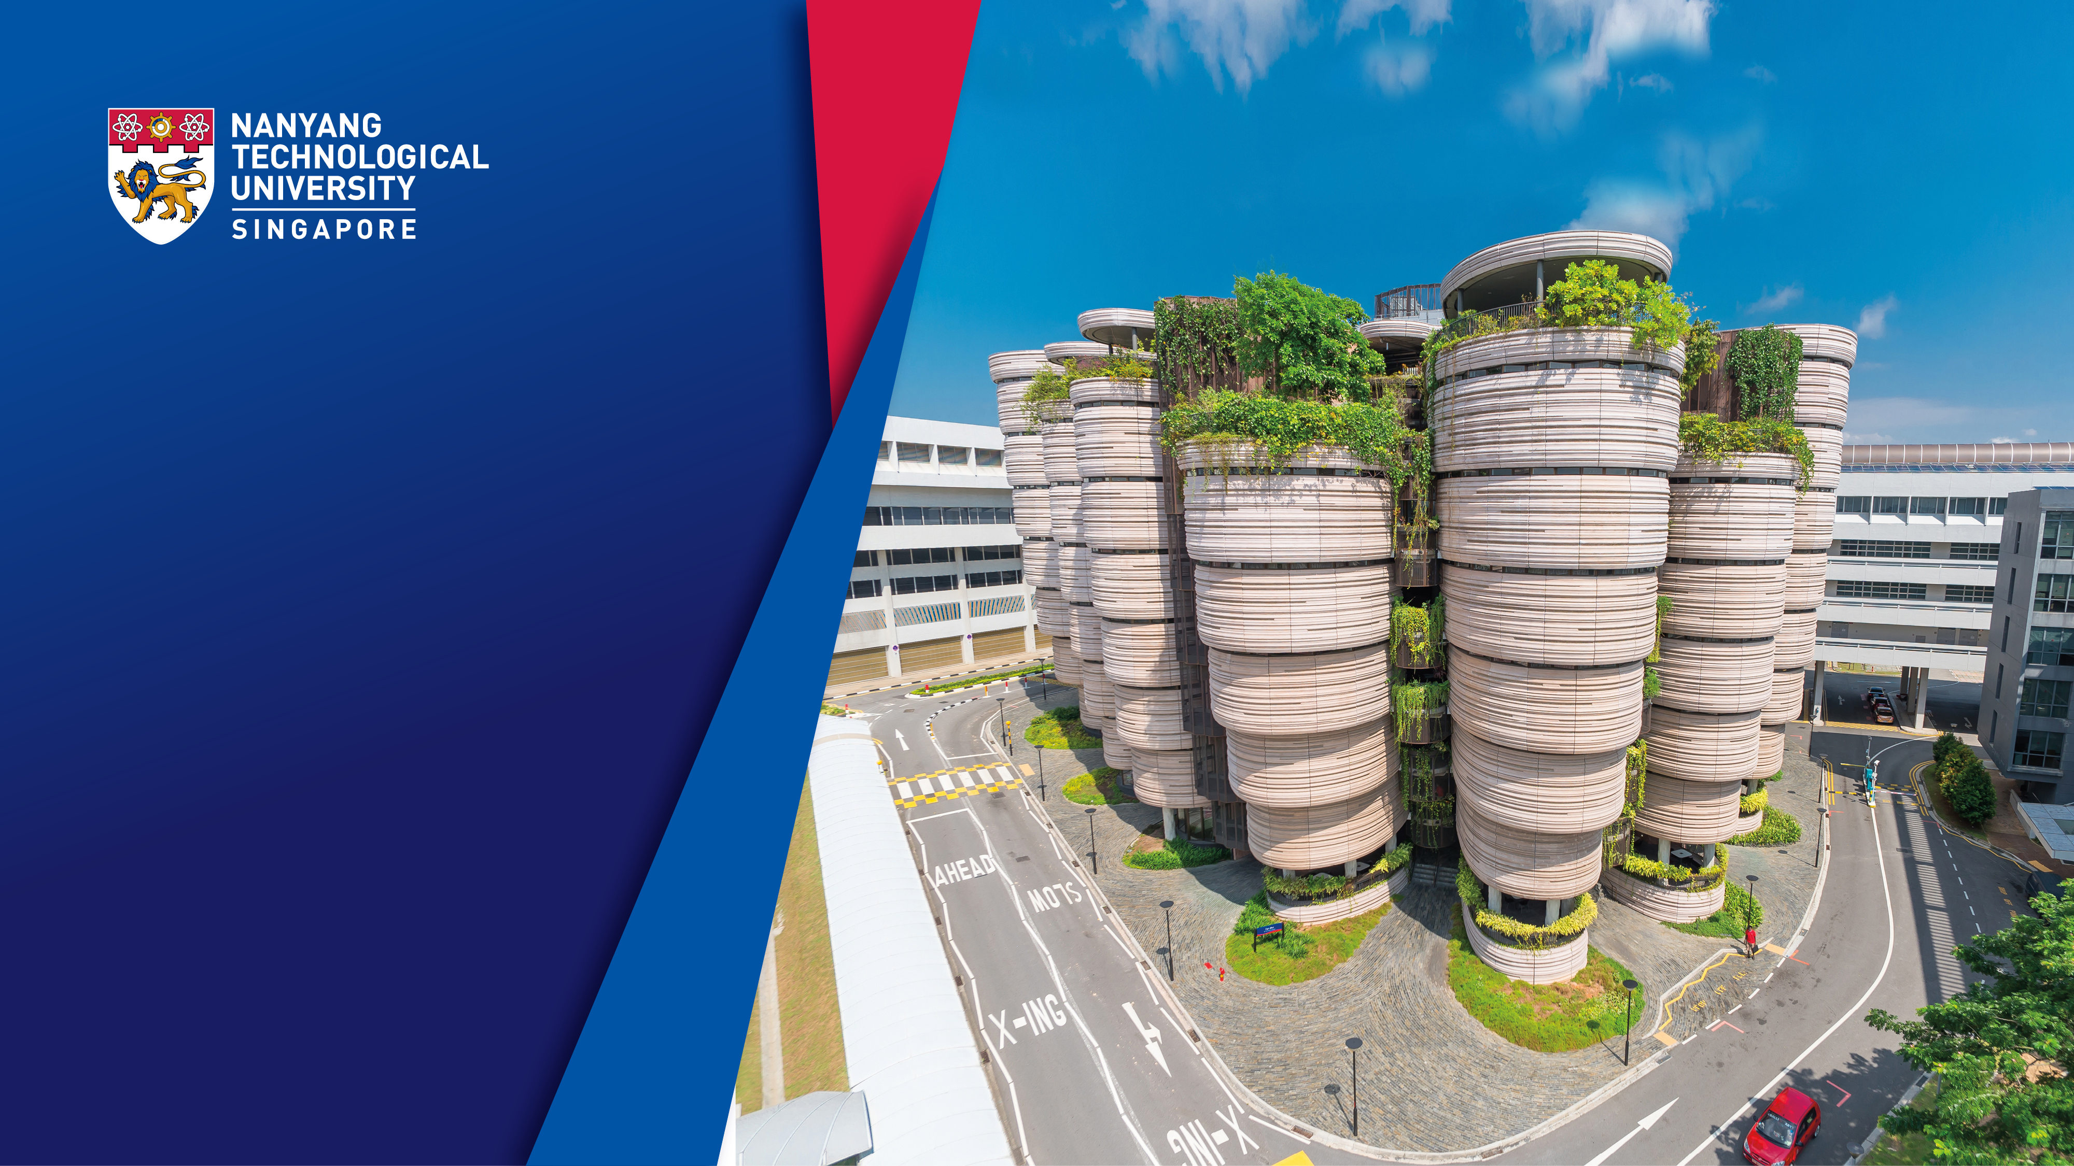

Implementing Research Integrity in a Rapidly-rising Asian university
Tony Mayer
Research Integrity Adviser
Nanyang Technological University, Singapore
Co-Chair 1st, 2nd and 5th World Conferences on Research Integrity
Workshop: Handling Research Misconduct Investigations – Legal and Practical Considerations
Taipei, Taiwan
29 August 2018

Slide 2
Contents
1. General remarks
2. About NTU
3. Putting policy and procedures in place
4. Five Case Histories
5. Conclusions: Lessons to be learned and new challenges

Slide 3

Research Integrity ≠ Research Misconduct
Research Integrity should address Good Research Practice/Responsible Conduct of Research
‘In general terms, responsible conduct in research is simply good citizenship applied to professional life’
“Making Mistakes and Making Breakthroughs: Taking Risks in Our Academic Life”
Professor Nick Steneck, University of Michigan,
Co-Chair 1st, 2nd & 5th World Conferences on Research Integrity

Slide 4
Research Misconduct
represents Failures at several levels
the Individual
the PI and Group/Laboratory
the Institution
the Funder
the Government

Slide 5

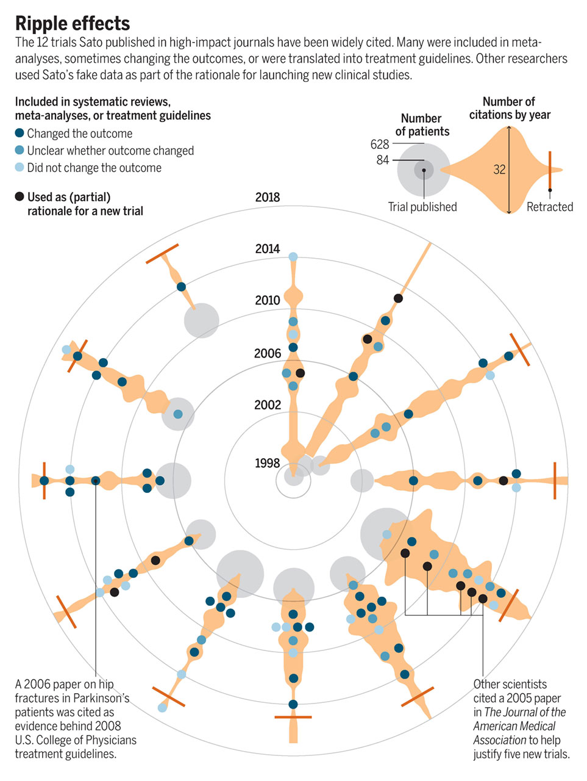
“Tide of Lies”
Kai Kupferschmidt
Illustration by Sara Gironi Carnevale Science Vol. 361, pp 637/641 (17 August 2018)

Slide 6
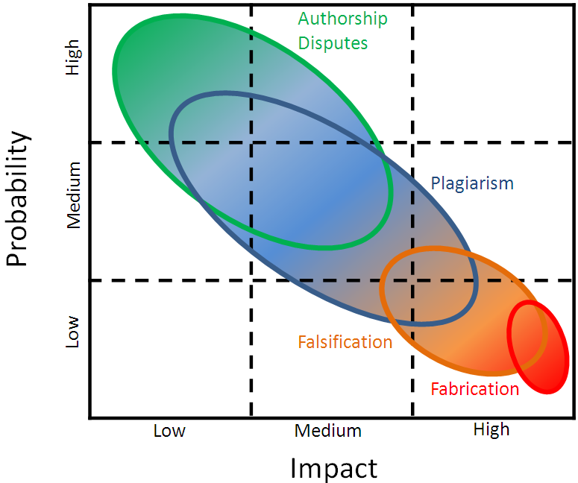
Research Misconduct - Frequency and Impact
By permission of Paul Taylor, RMIT

Slide 7


Different disciplines have different ways of working and disseminating results
Research integrity investigations have to take this into account

Slide 8
There are Multiple Pressures on the Individual
Part VI - 6
‘Stick-to-the-Basics’
■ Staff
■ Students
‘Good-Manners-Cost- Nothing’
■ Provide role models
■ Modesty trumps hubris
Research
Misconduct
Inadequate
Training
Poor
Mentorship
‘Life-is-Complicated’
■ Family pressure
■ Illness
■ Financial stress
Individual
Circumstances
‘The-Mind-Plays-Tricks’
■ Fear of failure
■ Perfectionism
Individual
Psychology
Competitive
Pressures
‘Winning-isn’t-Everything’
Publications ■ Funding ■ Positions ■ Prestige
Courtesy Tim White, NTU

Slide 9
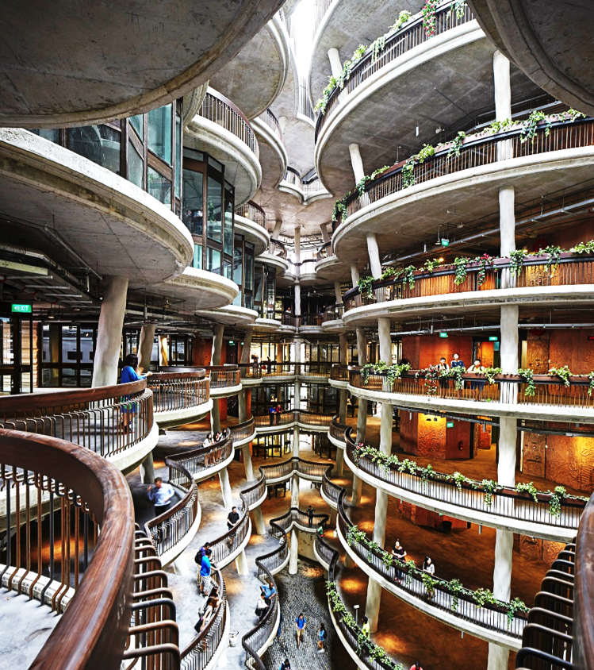
NTU Singapore: Background
Founded in 1991
≈33,500 students, ≈4,500 faculty & researchers
Originally, an engineering teaching university
Very rapid transformation into a research-intensive university
Introduction of many new disciplines, including arts, humanities & social sciences and now a new Medical School

Slide 10
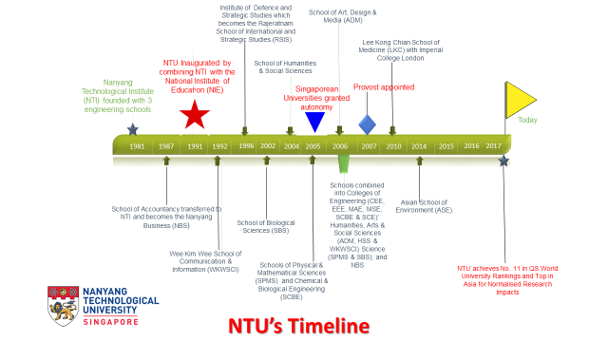

Slide 11
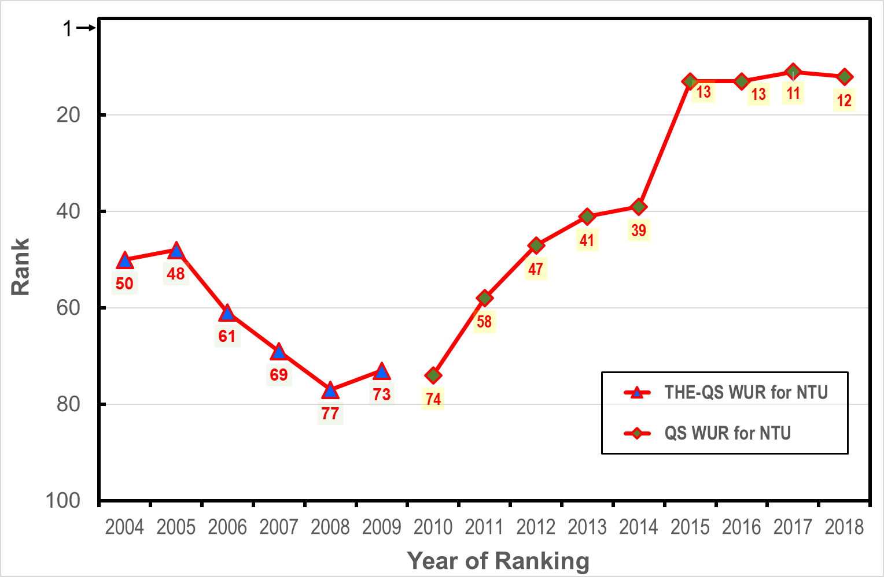
NTU’s Ranking Trends in THE-QS WUR and QS WUR
A moderately good and
well-resourced university
Into the World’s top 20

Slide 12
Charting NTU’s Rapid rise
Recently ranked the world’s no. 1 fastest rising young university by Times Higher Education
Ranked 12th in QS World University Ranking (high of 11th in 2017)
- Quantum leap of 62 places over 8 years
Ranked 52nd in Times Higher Education World University Rankings 2018
- Quantum leap of 122 places over 8 years
Ranked 1st in QS Asia University Rankings 2018
Ranked 1st in QS Top-50 under 50
74th in 2010
174th in 2010
14th in 2009
4th
in 2012

Slide 13
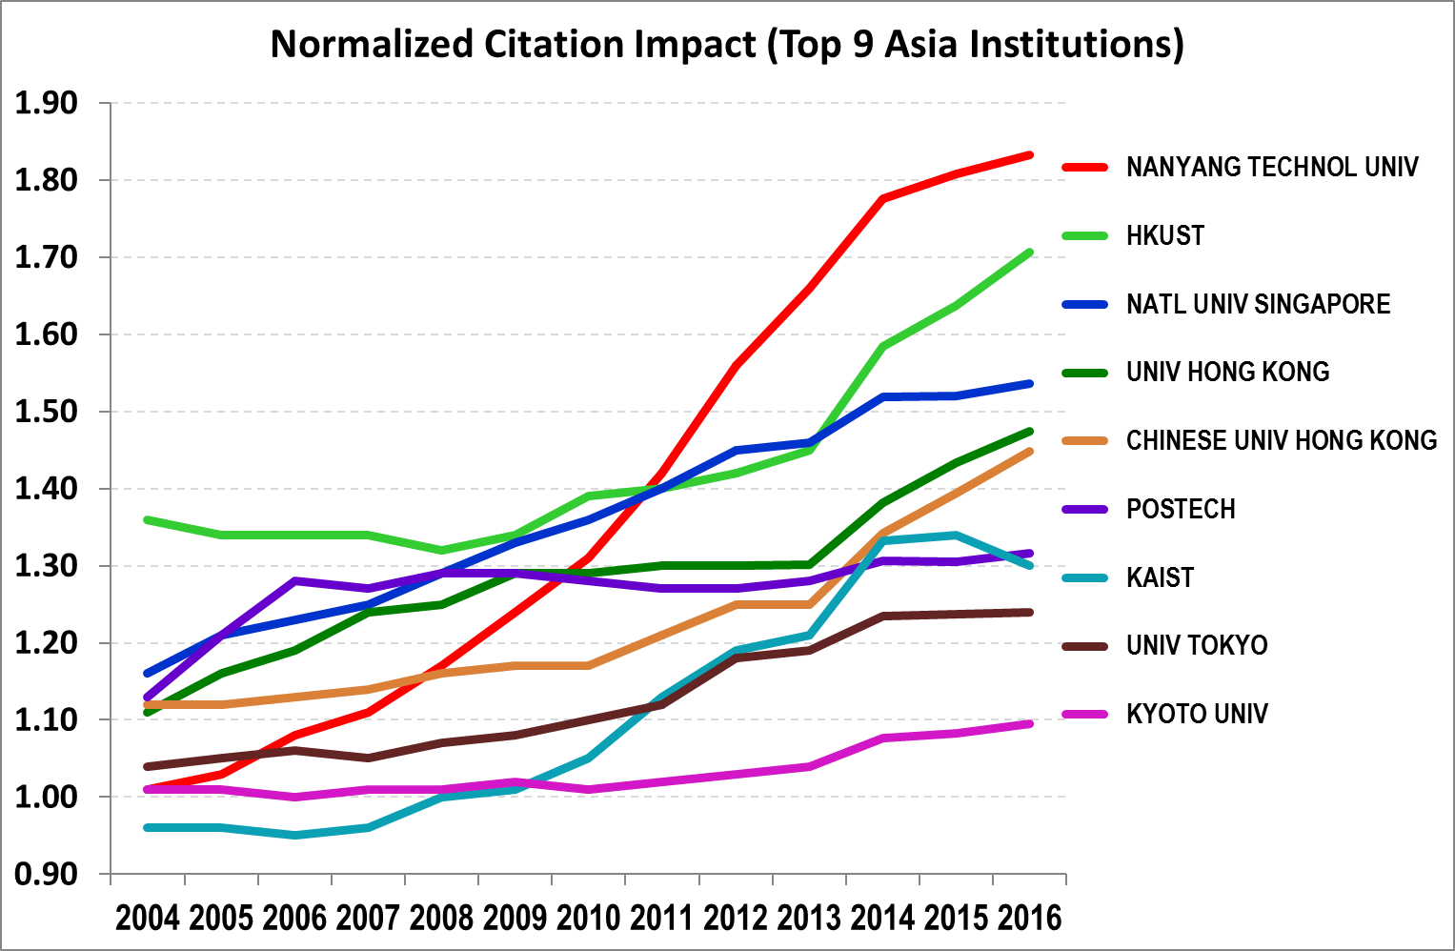
Normalized Citation Impact (NCI) for Top 9 Asian Institutions
Source: Clarivate Analytics InCitesTM

Slide 14
Putting RI into Operation (1)
Policy and procedures originally based on the ORI ‘template’, revised and updated to meet local concerns and relevant national legislative changes (PDPA and HBRA) in 2012 and 2018
Incorporates previous ‘guidance notes’ as policy
Procedures made compatible with university’s disciplinary processes
Strong support from the University Leadership and Board of Trustees (BoT)
Development of mandatory educational packages for faculty, research staff and students
Creation of university-wide RI network of ‘points of contact’ – now the Associate Chairs (Research) or equivalent

Slide 15
Putting RI into Operation (2)
Creation of a Research Integrity & Ethics Office (RIEO)
Supporting revised and updated IRB (formed 2012) and IACUC (formed 2007)
structures (2016/2018)
BoT adopts Enterprise Risk Management (ERM) as keynote policy – research integrity and data handling identified as high profile risks
Establishing mandatory Data Management Planning to address data concerns
Now moving into audit and compliance monitoring
Creating a grant call for research into research integrity in NTU (2018)

Slide 16
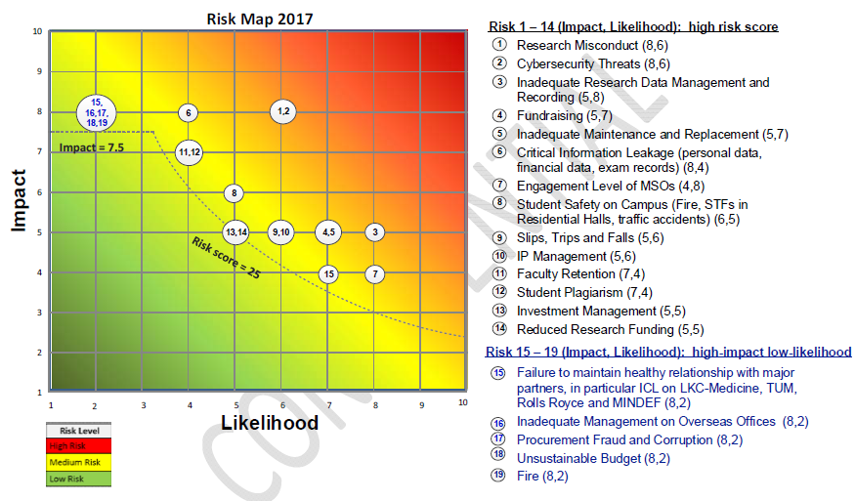
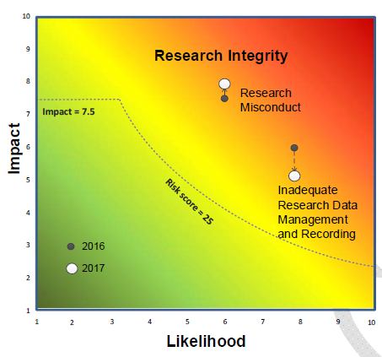
ENTERPRISE RISK MANAGEMENT (ERM)
NTU RISK MAP 2017
Risk #1: Research misconduct
Risk #3: Inadequate research data management and recording

Slide 17
Data
Planning research including mandatory Data Management Planning – DMP
Repeat experiments and data storage in multiple places and date stamped
University ‘owns’ all data
Need to retain & archive data for 10 years post publication/patent/project end
Transparency and accountability (open access)

Slide 18
Investigatory Procedures (1)
RIO, on receipt of allegations, starts preliminary investigation
All allegations, even anonymous, are investigated
Preliminary investigation by RIO, supported by RIEO with informal expert group as necessary
Chair always selected from a different College but with knowledge of the area
Members normally from other Schools but, if particular knowledge is needed, then this is not always possible (as in Case History 2)

Slide 19
Investigatory Procedures (2)
Preliminary report to Vice-President Research and Provost
RIO may conclude ‘No case to answer’, or it is a minor infringement with commensurate disciplinary actions, or a major breach of good research practice
NOTE: breaches of IRB or IACUC approvals are research misconduct
Major issues go to formal University Committee of Inquiry or Student Disciplinary Board (as appropriate) and may result in termination of employment, or expelling student and will lead to retractions and corrections
Composition: COI always chaired by a Full Professor, members from other Colleges & Schools with external (either Singaporean or overseas members)

Slide 20
Other NTU Initiatives
NTU led the hosting (with NUS and A*STAR and with support of MOE) of the 2nd World Conference on Research Integrity, 2010
2010 WCRI meeting adopted the Singapore Statement on Research Integrity
Sent delegations of 6+ to subsequent conferences
NTU proposed a Singapore meeting on Research Integrity (with A*STAR, NUS and SUTD)
All - Singapore conference, at instigation of NTU, held in November 2016 and led to the Joint Statement On Research Integrity relating to Scholarly Publications
Second All - Singapore meeting to be held on 22 October 2018 on Research Integrity relating to Data Reproducibility: proposal to create a National RIO Network

Slide 21
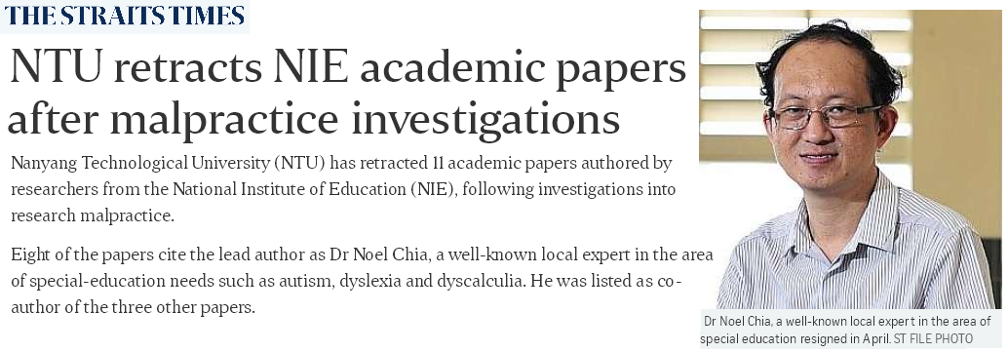



Case History 1 (a)

Slide 22
Case History 1 (b)
Societally sensitive area of children with special educational needs
Imported project when recruited to NTU/NIE in 2006 stating that contract was signed to write 10 papers on as yet unseen data!
Research project accepted & not checked
External whistle-blower (professional in same field) - difficult, obsessive and uncooperative whistle-blower who eventually involved police, Ministry of Education & politicians
Initial resistance from Institute concerned within NTU
Case alleged data fabrication through an invented person & invented organisation and invented data – how to find a ‘missing person’ claimed to be holding the data
Two distinct and opposing academic philosophies – is it misconduct or an academic disagreement/discourse

Slide 23
Case History 1 (c)
Role of a university is to investigate academic misconduct in an academic environment
Difficult to engage in ‘detective – private eye’ work esp. in another country with another language
Demonstrates limitations of university investigations
Data not available to check – claim it had been returned to the missing originators
Later, some data produced, consent forms subjected to handwriting experts & doubts raised
Faculty in question resigned prior to completion of investigation – final conclusion that he would have been dismissed
NTU seeks retractions of papers on basis of inability to authenticate data & lack of ethical approvals and suspicious circumstances surrounding ‘missing person’

Slide 24
Case History 1 (d)
Conclusions
Long drawn-out & complex case – was the response too slow and cumbersome
Shows limits to university’s powers of ‘criminal-type’ investigation with circumstantial allegations
Retractions imposed on respondent - Respondent now up to 22 retractions!
Whistle-blower contributed but now pursues innocent associates, including journals and COPE!
Raises trust on the appointment of faculty importing existing research projects & commitments – how far should one go in checking ‘imported’ research?
How does one deal with the obsessive whistle-blower?
When story ‘broke’ publicly, reluctance of institution to be transparent

Slide 25
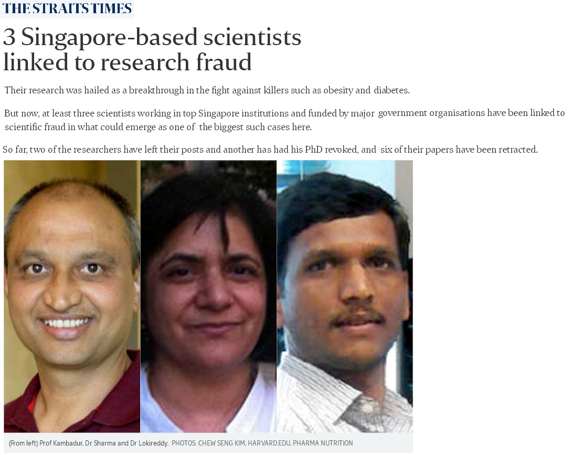
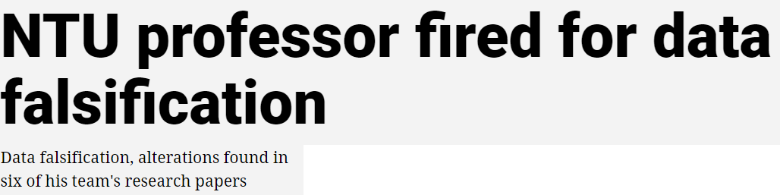

Case History 2 (a)
‘Classical’ Life Sciences case of fraudulent imagery manipulation
Involved 3 institutions in Singapore (NTU, A*STAR & NUS) & across countries: Singapore / United States of America / New Zealand
Key scientific area: Muscle-wasting & cancer – medical relevance with high scientific impact
16 July, 2016

Slide 26

Case History 2 (b)
Anonymous but substantiated allegations

Slide 27
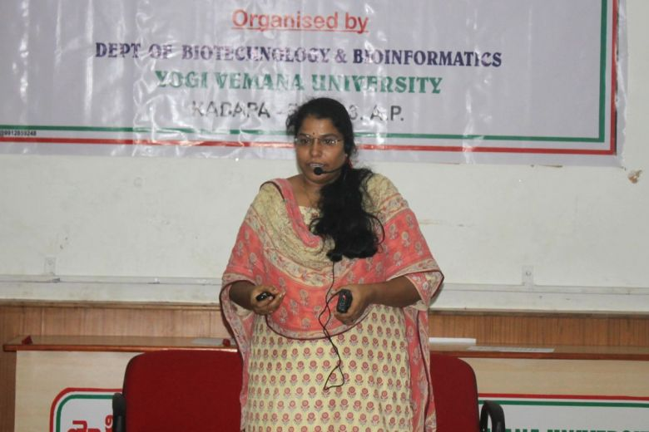

Case History 2 (c)
NTU revokes former A*Star scientist's PhD for doctoring data in research studies
In the initial investigation, Bonala vigorously denies wrong-doing
Bonala confesses to misconduct as a result of comments in PubPeer
Blames and implicates PI
PI ‘bullies’ Bonala – PI and senior A*STAR colleague suspended and all data sequestered and secured
Problem of trolls on newspaper web site
Ms Sabeera Bonala had her PhD revoked after admitting that she had falsified data in her research and doctoral thesis.
2 November 2017

Slide 28
Case History 2 (d)
Detailed forensic examination of Western blot images both internally and using external consultant
Case proven
Two PhDs revoked ONLY TIME THIS HAS HAPPENED
9 papers out of group output of 30 retracted
PI: Full Professor dismissed for ‘wilful negligence’ creating conditions for misconduct & turning a ‘blind eye’
Students left without supervisor (direct effect)
Students not accepted on joint programmes elsewhere (indirect effect) by tarnished reputation of laboratory
Grant agency seeking repayment
Consequences

Slide 29
Case History 3 (a): plagiarism of imagery
Consists of 2 incidents:
  In the 1st case, NTU became aware of allegations through a public blog site
  The 2nd case was a similar complaint in relation to a report on an internal grant
Misconduct allegations referred to:
  Plagiarism of images & of text
  Failure to provide provenance of images
  Possible copyright breaches
  Suspect payments

Slide 30
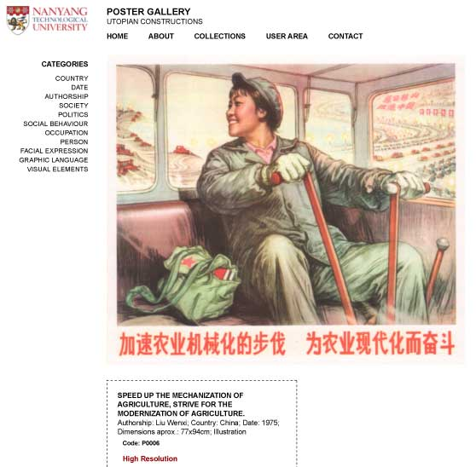

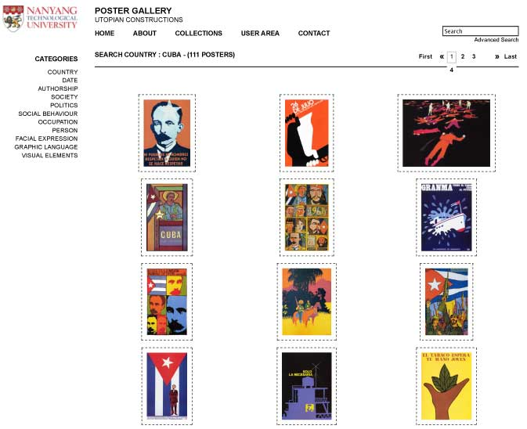

Case History 3 (b): plagiarism of imagery
First raised in whistle-blower’s website of which NTU became aware later
Docs Populi – March 20, 2013
Adventures in copyright violation:
The curious case of Utopian Constructions
“….I eventually reached professor xxx in the School of Art, Design and Media, College of Humanities, Arts and Social Sciences (NTU). I told him of my concerns, ……. the site was using 73 poster images from my book Revolucion! Cuban Poster Art (Chronicle Books, 2003) & 90 poster images from Chinese Posters: Art from the Great Proletarian Cultural Revolution (Chronicle Books, 2007) for which I was the co-author & responsible for all image provision…. I had two partners in pursuing this complaint, my publisher & the East Asian Library. Both wrote letters supporting my case. Although Dr xxxx agreed to the first request, he insisted on posting high-resolution images & did not have enough information to answer my third request”

Slide 31
Case History 3 (c)
Public accusation of plagiarism on blog site
Lengthy investigation lasting 2 years following initial acceptance of respondent’s statements
Respondent asked to provide imagery provenance statements and include copyright disclaimers: not implemented
Second case of similar nature reported and triggers complete re-investigation
Imagery plagiarism & external software experts needed
Plagiarism & copyright infringement proven
Misrepresentation of university legal services & Ministry of Education
Investigation uncovered suspect payments out of country and maladministration
Full Professor dismissed
Attempts to sue university/people

Slide 32

Case History 4 (a): hacking to increase citations!
Research Fellow reported to have hacked into Elsevier review site & referred to NTU
Investigation delayed due to publishers legal advisers reluctance to share data
Case proven – 122 instances of hacking!
Reason was an attempt to improve the respondent’s own citation record!
Respondent resigned but NTU referred the case to the Singapore Police Force under Misuse of Computers legislation
Pathetic obsession with citations for career advancement

Slide 33
Case History 4 (b): hacking to increase citations!
Conclusions
Is this an extreme example of institutions’ obsession with citations
Demonstrates that firewalls are susceptible to the determined hacker
Investigation delayed due to publishers legal advisers reluctance to share data – problem of data sharing between institutions in investigations
New information: Respondent seeking academic post in his home country
should NTU proactively follow up?
if not, are we failing to fulfil our responsibility to the academic community or are we persecuting the culprit?

Slide 34
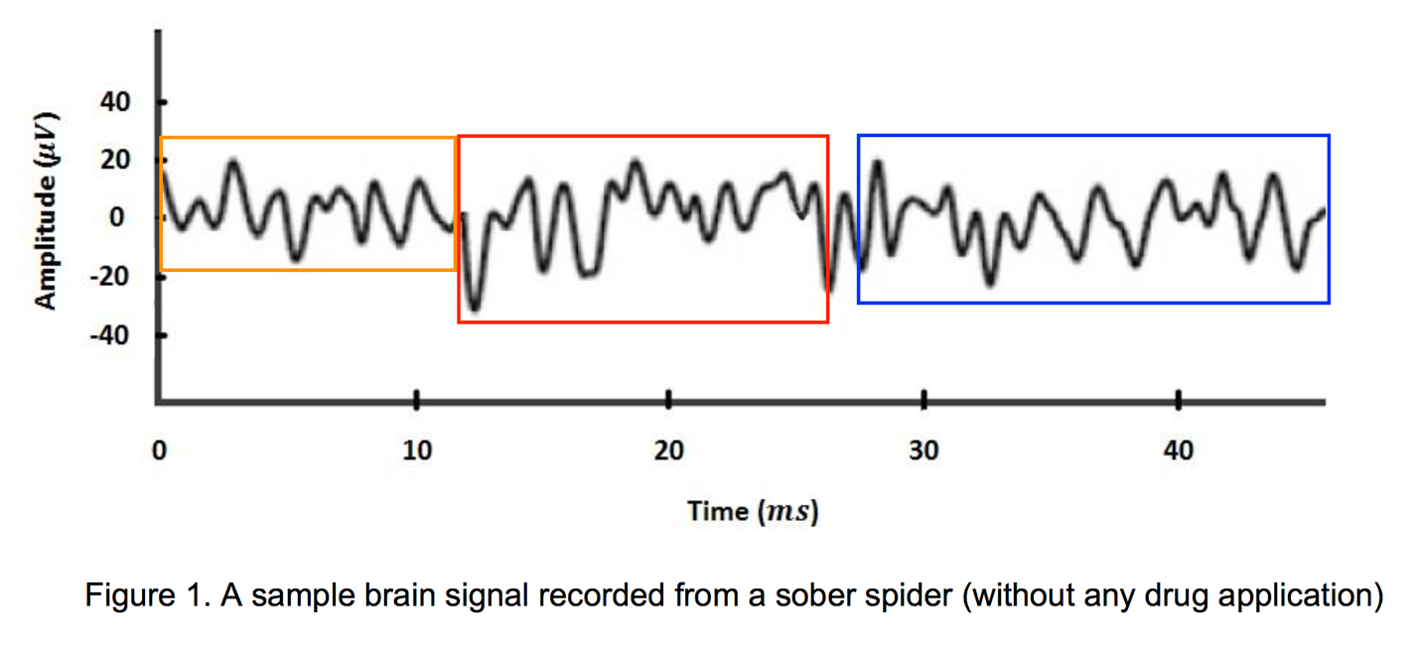
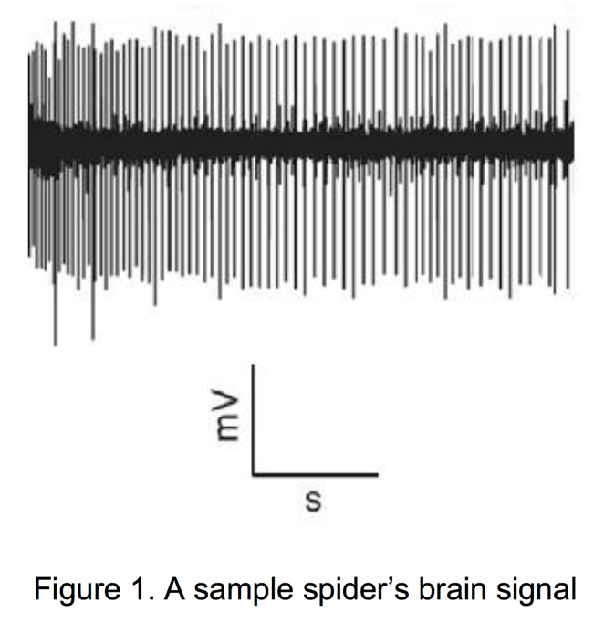

Case History 5 (a): False claims of ethical approval
Interesting manuscript on spiders’ webs by Research Fellow
submitted to journal
Reviewers spotted plagiarism
Publisher referred case and related matters to NTU
Manuscript
Original paper

Slide 35
Case History 5 (b): False claims of ethical approval
Co-author from NUS so expert group has NUS representation
Unethical approaches to authorsip
Inquiry finds plagiarism proven plus falsification of plagiarised data and Research Fellow dismissed
Review of other papers shows consistent false statements of ethical approvals - respondent says “we mistakenly wrote that statement about NTU as we did not know what it really means”!
Data inadmissible and NTU seeks retractions in all cases (9)
Journals slow & reluctant to retract – only half retracted

Slide 36
Case History 5 (c): False claims of ethical approval
Conclusions
Benefit of having an external view
Misconduct shown in other papers
NTU regards breaches of ethical approvals as research misconduct and invokes RI policy and procedures
Disappointing reaction from journals – failure to acknowledge ; slow to respond; reluctant to retract
Journals criticise research institutions but this is an example of a reverse problem

Slide 37
Case History 5 (c): False claims of ethical approval
Conclusions
Benefit of having an external view
Misconduct shown in other papers
NTU regards breaches of ethical approvals as research misconduct and invokes RI policy and procedures
Disappointing reaction from journals – failure to acknowledge ; slow to respond; reluctant to retract
Journals criticise research institutions but this is an example of a reverse problem

Slide 38
Malicious Cases
New Dean appointed: pursued by plagiarism accusations by former colleague – Malicious allegation by vengeful person
Allegation of misconduct by senior faculty (full Professor) against more Associate Professor relating to poor handling of pathogens – not proven and shown to be malicious
Allegations of data fabrication by former colleague of NTU Professor – case of proven fabrication by US-based lead author whose co-authors were fully exonerated – shown to be malicious

Slide 39

Challenges to be faced
Challenges of developing research integrity in a rapidly-developing university in a competitive environment
Aggravating factors such as hierarchy, heterogeneous faculty & “tolerance”
Tendency to regard RI as a bureaucratic imposition
Investigations of research integrity cases may need competencies outside the traditional academic framework
Sharing of experiences essential

Slide 40
Clear lines of action needed
Mentor the Mentors
Train the Trainers
Mandatory Training of Researchers in Good Practice and Strong Ethics

Slide 41
Data Reproducibility is the Key
Planning research including Data Management Planning - DMP
Open access
Transparency and accountability

Slide 42
Need to give credit for Good Research Practice
Conduct multiple experiments
Ensure data is saved in multiple databases with ample security and date stamped and is searchable and accessible. Citing such sources gives credit to the researcher
One-off data gathering (e.g. social surveys and clinical trials) has to be meticulous
Outliers and negative results have to be reported
Journals should publish/report repeat and replicability studies and negative outcomes

Slide 43






Need for International Collaboration in Research Integrity: the World Conferences on Research Integrity
Second Conference (2010) Singapore Statement on principles and responsibilities in Research Integrity
Third Conference (2013) Montréal Statement on Integrity in Research Collaborations
Fifth Conference (2017) Amsterdam Agenda to assess efforts to improve research integrity & the use of empirical information developing RI policies
Sixth Conference (2019) Hong Kong Declaration?

Slide 44

www.wcri2019.org
Deadlines for abstracts (October 15)

Slide 45


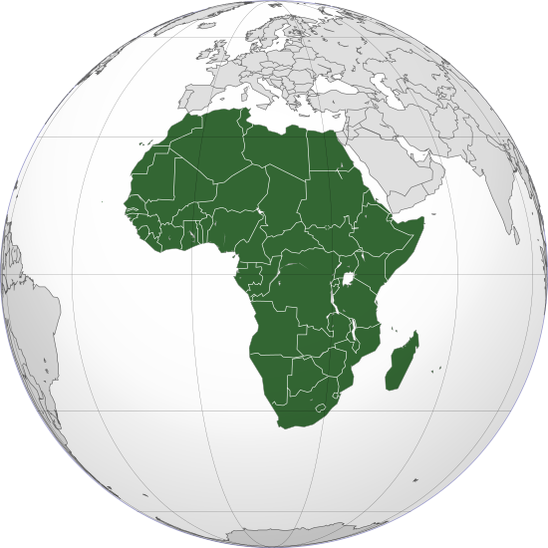
Need for International Collaboration in Research Integrity: Regional Networks in Research Integrity
ENRIO - European Network of Research Integrity Offices
APRI - Asia-Pacific Research Integrity Network
ARIN - African Research Integrity Network

Slide 46

Major New Challenges in Research Integrity
Big increase worldwide in the number of researchers and volume of research funding
Increasing trend of international, multi-authored publications
Changing technologies
Open Access
Imagery manipulation – technological advances lead to stricter rules from journals
Predatory Journals distorting publication
Rise of ‘contract’ PhDs – extra vigilance required

Slide 47
References
Singapore Statement on Research Integrity, 2010
https://wcrif.org/guidance/singapore-statement
Montréal Statement on Research Integrity in Cross-Boundary Research Collaborations
https://wcrif.org/guidance/montreal-statement
Amsterdam Agenda
https://wcrif.org/documents/42-amsterdam-agenda/file
Global Research Council: Statement of Principles for Research Integrity
https://www.globalresearchcouncil.org/fileadmin/documents/GRC_Publications/grc_statement_principles_research_integrity_FINAL.pdf

Slide 48
mulțumesc
Thank You !
谢谢!
Diolch!
Hvala vam

